Slide 1
The c programming
Presenter: Trinh Cao Cuong
3/2024

Slide 2
Table of contents
1. Memory layout*
2. Variable and operator*
3. Pointer & Array
4. Function, inline function, marco
5. struct, enum, union
6. summary
* Advanced only

Slide 3
1.
Memory layout

Slide 4
2.
Variable & operator.

Slide 5
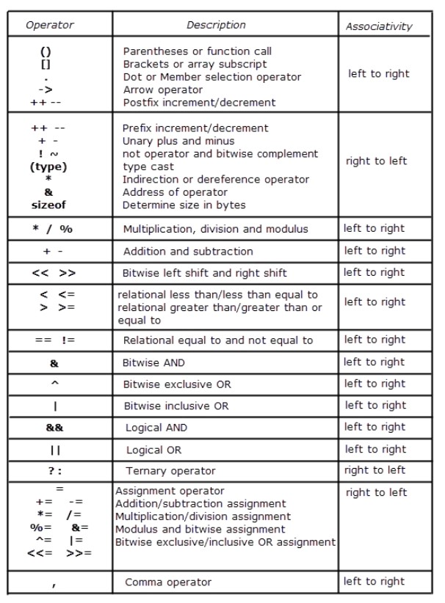
Variable & operator : operator in c
Table beside describes the precedence order and associativity of operators in C.
The precedence of the operator decreases from top to bottom.
Operator Precedence and Associativity is the concept that decides which operator will be evaluated first in the case when there are multiple operators present in an expression.

Slide 6
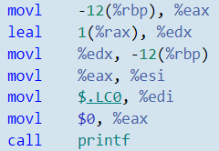
Variable & operator : postfix ++ --
The postfix a++, a-- work as below:
Create temp value of a
Increase value of a
Return temp value to printf
a-- is the same work flow

Slide 7
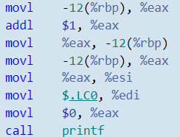
Variable & operator : prefix ++ --
The postfix ++a, --a work as below:
Increase value of a
Return a value to printf
--a is the same work flow

Slide 8
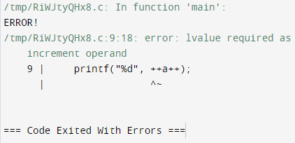
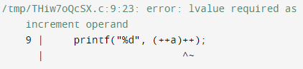
Variable & operator : prefix combine with postfix
Prefix and postfix return value in register but not address (lvalue error)
Postfix has more precedence than prefix

Slide 9
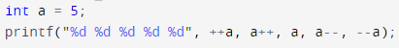
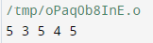
Variable & operator : prefix combine with postfix
() : Ordering from right to left
--a : a = 4 but not return value here
a-- : a = 3 and return a = 4
a : a = 3 but not return value here
a++ : a = 4 and return a = 3
++a : a = 5 but not return value here
Next: return value to --a = a = ++a = 5

Slide 10
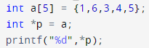
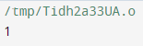
Variable & operator : prefix ,postfix combine with *
*p | 1
++*p | 2
++(*p) | 2
*++p | 6
*(++p) | 6
*p++ | 1
*(p++) | 1

Slide 11
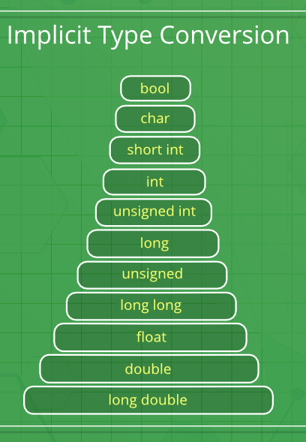
Variable & operator : type casting
Implicit type conversion: Done by compiler on its own, All the data types of the variables are upgraded to the data type of the variable with the largest data type
Explicit type conversion: (type) expression
It return a temp value

Slide 12
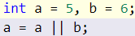
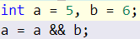
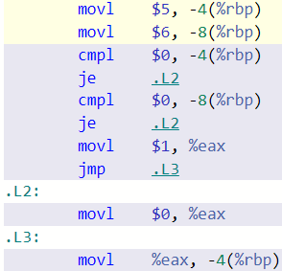
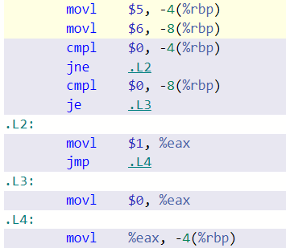
Variable & operator : logic operator
Logic operator will check:
- ||: if argument = 1 then jump
- &&: if argument = 0 then jump
This feature in order to reduce stress and error

Slide 13
3.
POINTer & array.

Slide 14
POINTer & array : pointer declare
A pointer type variable holds the address of a data object or a function.
Note that the placement of the type qualifiers volatile and const affects the semantics of a pointer declaration.
If either of the qualifiers appears before the *, the declarator describes a pointer to a type-qualified object. If either of the qualifiers appears between the * and the identifier, the declarator describes a type-qualifed pointer.
Pointer is a address value and store in memory by 64-bits or 32-bits (depend on OS), same as type long long int

Slide 15
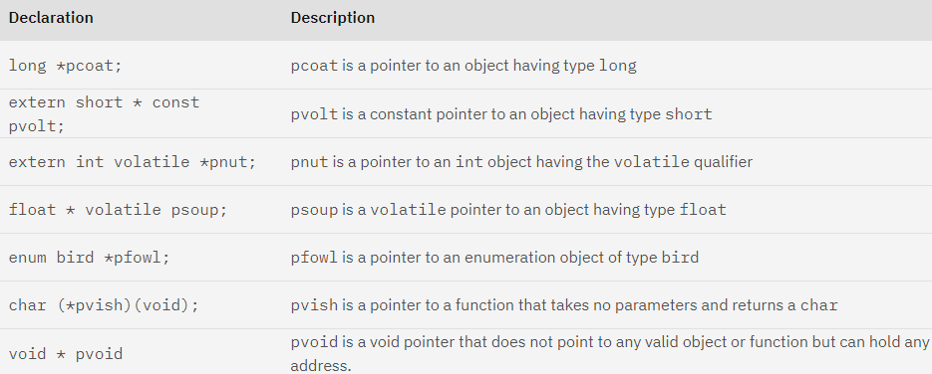
POINTer & array : pointer declare

Slide 16
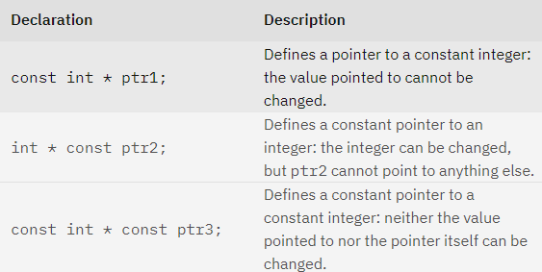
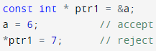
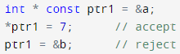
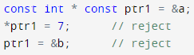
POINTer & array : const pointer declare

Slide 17
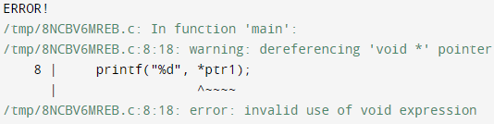
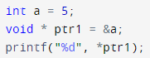
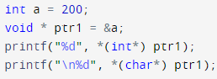
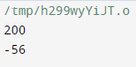
POINTer & array : void pointer declare
Void pointer hold a address but couldn’t read or write value pointed.
User can casting type of void pointer to using.

Slide 18
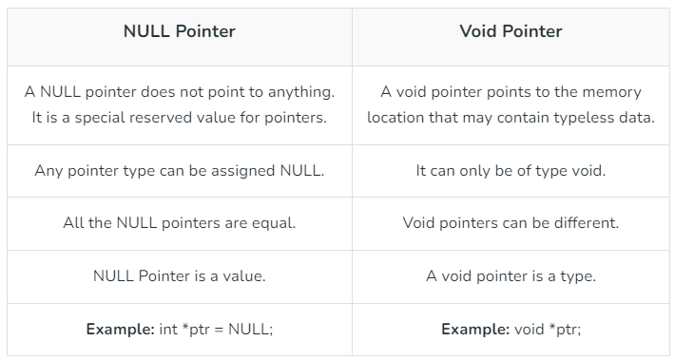
POINTer & array : Null pointer vs. void pointer

Slide 19
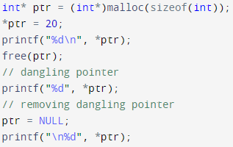
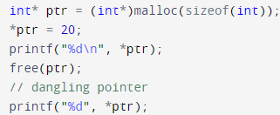
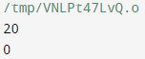
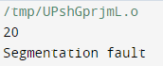
POINTer & array : dangling pointer
A Pointer pointing to a memory location that has been deleted (or freed) is called a dangling pointer.
Such a situation can lead to unexpected behavior in the program and also serve as a source of bugs in C programs.

Slide 20
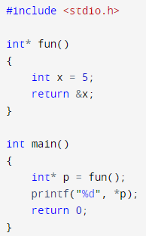
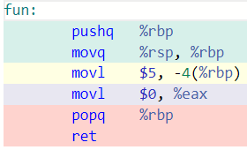
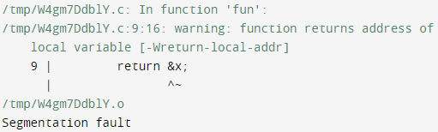
POINTer & array : dangling pointer
Return Address is 0 but couldn’t access to address 0
-> Segment fault

Slide 21
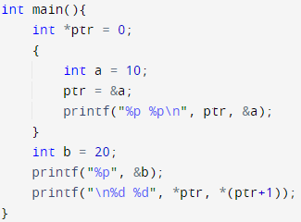
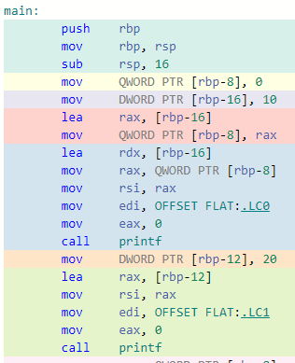
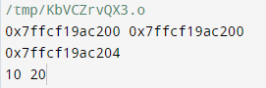
POINTer & array : dangling pointer
ptr now is a dangling pointer, it can access to var a address (out of scope)
-> not raise ERROR

Slide 22
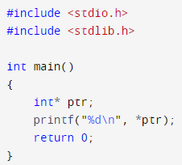
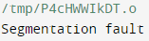
POINTer & array : Wild pointer
ptr now is a wild pointer, it may be initialized to a non-NULL garbage value.
-> Segment fault when trying access to that garbage value

Slide 23
POINTer & array : restrict qualified
Objects referenced through a restrict-qualified pointer have a special association with that pointer. All references to that object must directly or indirectly use the value of this pointer. In the absence of this qualifier, other pointers can alias this object. Cacheing the value in an object designated through a restrict-qualified pointer is safe at the beginning of the block in which the pointer is declared, because no pre-existing aliases may also be used to reference that object. The cached value must be restored to the object by the end of the block, where pre-existing aliases again become available. New aliases may be formed within the block, but these must all depend on the value of the restrict-qualified pointer, so that they can be identified and adjusted to refer to the cached value. For a restrict-qualified pointer at file scope, the block is the body of each function in the file.

Slide 24
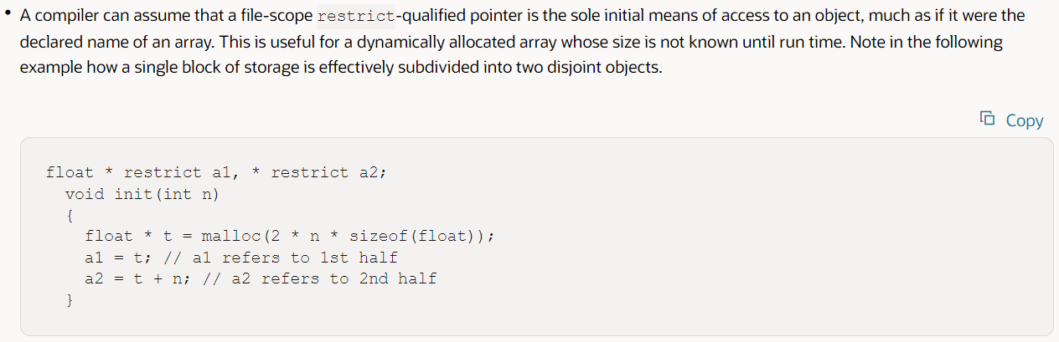
POINTer & array : restrict qualified

Slide 25
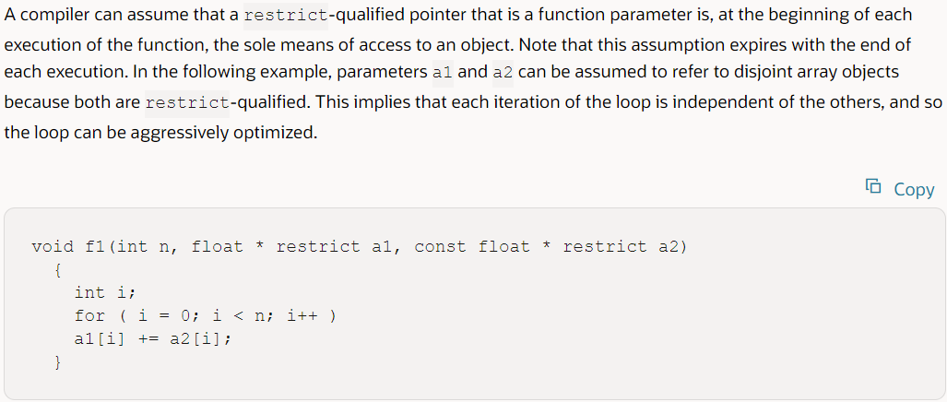
POINTer & array : restrict qualified

Slide 26
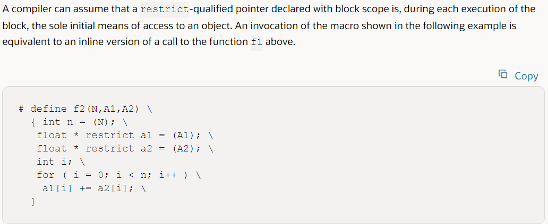
POINTer & array : restrict qualified

Slide 27
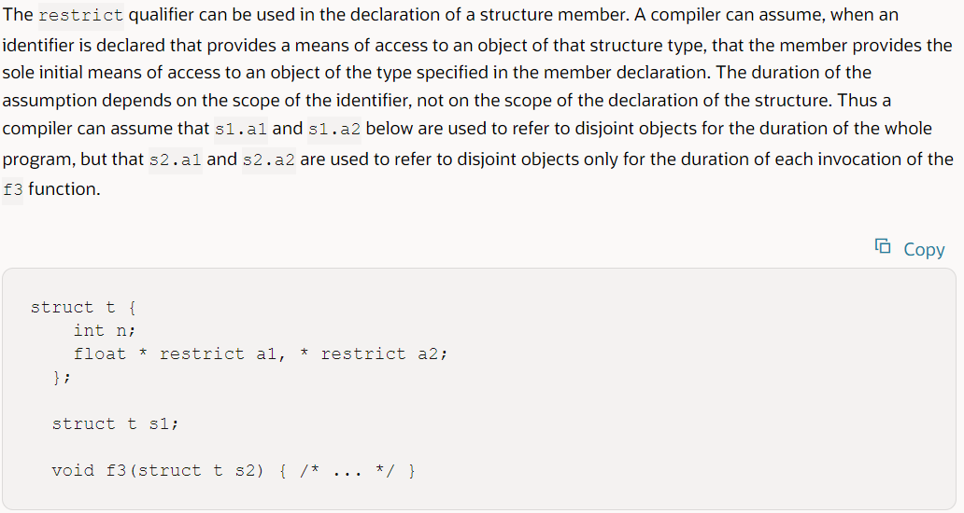
POINTer & array : restrict qualified

Slide 28
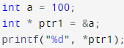
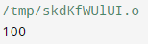
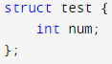
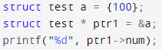
POINTer & array : pointer arithmetic
Pointer operator:
Operator *, ->, &
Increment and decrement
Addition and subtraction
Comparison
Assignment
Array
Operator *: using to get the value pointed to
Operator &: using to get the address of variable
Operator ->: using to get the value pointed to but using only with struct pointer

Slide 29
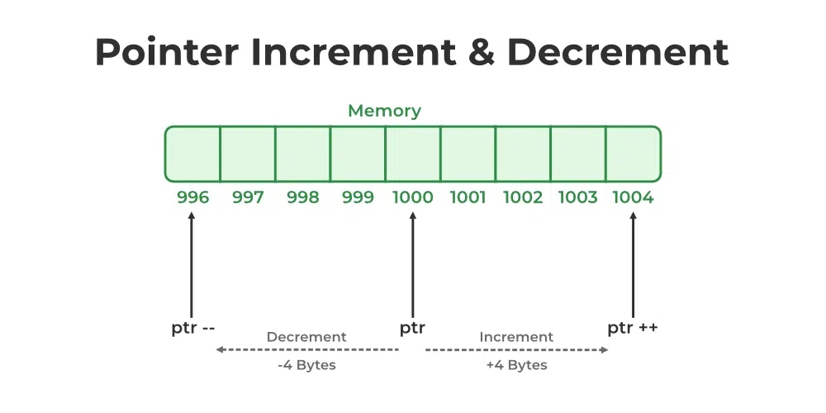
POINTer & array : pointer arithmetic
Pointer operator:
Operator *, ->, &
Increment and decrement
Addition and subtraction
Comparison
Assignment
Array
Prefix ++
Prefix –
Postfix ++
Postfix --

Slide 30
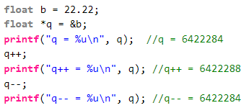
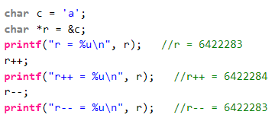
POINTer & array : pointer arithmetic
Pointer operator:
Operator *, ->, &
Increment and decrement
Addition and subtraction
Comparison
Assignment
Array

Slide 31
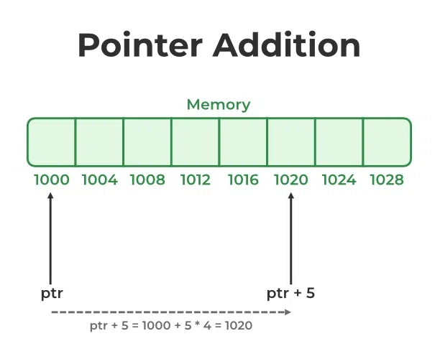
POINTer & array : pointer arithmetic
Pointer operator:
Operator *, ->, &
Increment and decrement
Addition and subtraction
Comparison
Assignment
Array
int pointer:

Slide 32
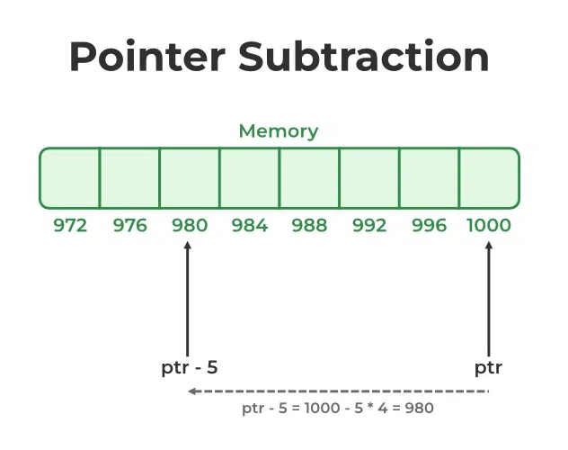
POINTer & array : pointer arithmetic
Pointer operator:
Operator *, ->, &
Increment and decrement
Addition and subtraction
Comparison
Assignment
Array
int pointer:

Slide 33
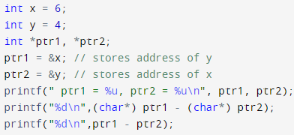

POINTer & array : pointer arithmetic
Pointer operator:
Operator *, ->, &
Increment and decrement
Addition and subtraction
Comparison
Assignment
Array
Subtraction of 2 pointer:

Slide 34


POINTer & array : pointer arithmetic
Pointer operator:
Operator *, ->, &
Increment and decrement
Addition and subtraction
Comparison
Assignment
Array

Slide 35

POINTer & array : pointer arithmetic
Pointer operator:
Operator *, ->, &
Increment and decrement
Addition and subtraction
Comparison
Assignment
Array
Assignment: 2 types:

Slide 36

POINTer & array : pointer arithmetic
Pointer operator:
Operator *, ->, &
Increment and decrement
Addition and subtraction
Comparison
Assignment
Array
Array: name can use same as const pointer
With:
That:

Slide 37



POINTer & array : pointer arithmetic
Pointer operator:
Operator *, ->, &
Increment and decrement
Addition and subtraction
Comparison
Assignment
Array
Multi-dimensional Array:
Address of array
1
2
3
4

Slide 38

POINTer & array : pointer to pointer
Multilevel pointer in C:

Slide 39


POINTer & function: function pointer
In C, like normal data pointers (int *, char *, etc), we can have pointers to functions. You can using this pointer to call function.
Function pointer (point to function fun)

Slide 40


POINTer & function: function pointer
Fact:
1. Unlike normal pointers, a function pointer points to code, not data. Typically a function pointer stores the start of executable code.
Calling function -> go to fun

Slide 41


POINTer & function: function pointer
Fact:
2. we do not allocate de-allocate memory using function pointers

Slide 42

POINTer & function: function pointer
Fact:
3. A function’s name can also be used to get functions’ address

Slide 43



POINTer & function: function pointer
Fact:
4. We can have an array of function pointers
5. Function pointer can be used in place of switch case
Array of function poiter
Switch case

Slide 44


POINTer & function: function pointer
Fact:
6. Like normal data pointers, a function pointer can be passed as an argument and can also be returned from a function.
Application: Run any function passed (callback)

Slide 45
POINTer & function: function pointer
Fact:
6. Like normal data pointers, a function pointer can be passed as an argument and can also be returned from a function.
Application: Run any function passed (callback)

Slide 46
POINTer & function: function return pointer
Function pointer:
What happen if function pointer missing the bracket???
-> It declare function that return void pointer

Slide 47
POINTer & memory: Dynamic memory allocation
Require: <stdlib.h>

Slide 48
4.
function

Slide 49


function: declarations
A function declaration tells the compiler that there is a function with the given name defined somewhere else in the program

Slide 50


function: declarations
Using function without declare will raise a warning but not error

Slide 51



function: definitions
The function definition consists of actual statements which are executed when the function is called
Old define

Slide 52


function: implicit return type
In C, if we do not specify a return type, compiler assumes an implicit return type as int. However, C99 standard doesn’t allow return type to be omitted even if return type is int. This was allowed in older C standard C89.

Slide 53


function: main function
main() function called first in program.
main() has it own parameters (commad line arguments) and return type as other function:
How many argument passed + 1
String array argument passed
Return type
(void is no return)

Slide 54


function: nested function
The function definition in other function will private in that function
Can compile but can’t run

Slide 55



function: nested function
Other error: Declare and call function in same block, compiler understand it is 2 declare but not call
fix
Compile fail

Slide 56



function: parameter passing – pass by value
Changes made to formal parameters do not get transmitted back to the caller.
Get value a = %edi
%edi = value x

Slide 57



function: parameter passing – pass by reference
Pass memory address (pointer) of a variable allows the function to access and modify the content at that
particular memory location.
a = %rdi = address of x
%rdi = address of x

Slide 58


function: parameter passing – ORdering
Function call parameter from right to left:
x = 5
%ecx = 5 + 3
%edx = 5 + 2
%esi = 5 + 1
%edi = 5

Slide 59


function: ellipsis argument
An ellipsis is used to represent a variable number of parameters to a function,
must always be the last argument.

Slide 60

function: variadic function
Variadic functions are functions that can take a variable number of arguments.
Require: <stdarg.h>
Declaring pointer to the argument list
Initializing argument to the list pointer
This ends the traversal of the variadic function arguments
Accessing current variable and pointing to next one

Slide 61


function: const parameter
Qualify a function parameter using the const keyword indicates that the function will treat the argument that is passed as a constant.

Slide 62




function: inline function
By declaring a function inline, you can direct GCC to make calls to that function faster. One way GCC can achieve this is to integrate that function's code into the code for its callers.

Slide 63


function: inline function
Inline Function are those function whose definitions are substituted at the place where its function call is happened
REF: https://gcc.gnu.org/onlinedocs/gcc/Inline.html

Slide 64
function: noinline FUNCTION attribute
Function attribute noinline prevents a function from being considered for inlining. It also disables some other interprocedural optimizations; it’s preferable to use the more comprehensive noipa attribute instead if that is your goal.

Slide 65


function: Function-like macros
These macros are the same as a function call. It replaces the entire code instead of a function name. Pair of parentheses immediately after the macro name is necessary.
If we put a space between the macro name and the parentheses in the macro definition, then the macro will not work.
With variable argument:

Slide 66


function: CONST FUNCTION attribute
Declaring functions with the const attribute allows GCC to avoid emitting some calls in repeated invocations of the function with the same argument values.
For example:
Const attribute tells GCC that subsequent calls to function foo with the same argument value can be replaced by the result of the first call regardless of the statements in between.

Slide 67
function: aligned FUNCTION attribute
Aligned attribute specifies a minimum alignment (in bytes) for variables of the specified type.
Alignment is crucial for efficient memory access, especially when dealing with SIMD (Single Instruction, Multiple Data) instructions or hardware that imposes penalties for unaligned access.

Slide 68
function: WEAk FUNCTION attribute
The weak function attribute causes the symbol resulting from the function declaration to appear in the object file as a weak symbol, rather than a global one. The language feature provides the programmer writing library functions with a way to allow function definitions in user code to override the library function declaration without causing duplicate name errors.

Slide 69




function: WEAk FUNCTION attribute
Not duplicate declare function
Duplicate declare function

Slide 70
5.
Struct, enum, union.

Slide 71
6.
summary

Slide 72

Sanfoundry
Segment fault
Khong co cau trl dung
Syntax error
Giải thích: in ra *ptr là việc truy cập vào vùng nhớ có địa chỉ ‘s’ -> segment fault

Slide 73

Giá trị in ra:
5 5
5
Không in ra
6
Giải thích: NULL là con trỏ void, có giá trị bằng 0 khi ép kiểu sang int

Slide 74

In ra:
8
4
2
Lỗi biên dịch
Giải thích: mặc định
sizeof(const floating number) = sizeof(double) = 8 bytes
Sizeof(character) = sizeof(int) = 4 bytes
Sizeof(int too long) = sizeof(long) or sizeof(long long) = 8 or 16

Slide 75

Các ví dụ bổ sung

Slide 76


Các ví dụ bổ sung

Slide 77

Kiểu dữ liệu nào không thể dùng trong câu lệnh switch:
float
int
char
enum
Giải thích: ví dụ trên

Slide 78


Kết quả của chương trình sau:
Greater
Smaller
100
Lỗi biên dịch
Giải thích: sau khi thực hiện toán tử 3 ngôi ?, câu lệnh tương đương với printf(“Greater”,str) -> in ra Greater
Chứng minh:

Slide 79

Kết quả của chương trình sau:
4
6
5
1
Giải thích: a[1] là 1 địa chỉ, có thể in ra hello từ a[1]. Địa chỉ có thể bằng 4 bytes với 32 bit và 8 bytes với 64 bit.
Trong điều kiện bài toán này, chỉ có thể chọn 4

Slide 80
Lựa chọn nào cho phép liên kết file thư viện trong gcc:
-L
-l
-link
Không có
Giải thích:
-L [addr] là liên kết các file thư viện nằm tại [addr]
-l chỉ đơn giản là cách viết tương đương: -lfun ~ libfun.so ~ libfun.dll
-link : không tồn tại

Slide 81

Kết quả:
4
4 + sizeof(int)
1
0
Giải thích:

Slide 82
Trong 1 chương trình C++ phải có:
Hàm main
Kiểu dữ liệu trả về của hàm main
Marco #include
Biến toàn cục
Giải thích:

Slide 83

Kết quả:
Biên dịch lỗi
Phụ thuộc trình biên dịch
15 15
16 16
Giải thích: lấy giá trị từ con trỏ void mà không ép kiểu

Slide 84

Kết quả:
1900
2000
2020
1800
Giải thích: …

Slide 85

Câu lệnh nào thực thi file a.out:
gcc sand.c
gcc –o sand.c
gcc –o a.out
gcc a.out
Giải thích: …

Slide 86

Kết quả:
40
30
20
50

Slide 87

Kết quả:
-2 3 1 1
3 3 1 2
-2 3 1 0
1 2 3 1

Slide 88

Kết quả:
4
5
6
3

Slide 89

Kết quả:
Lỗi biên dịch
Segment fault
4
8

Slide 90
Phần khai báo biến nội bộ theo chuẩn anci C:
Đặt ngay sau dấu { đầu tiên của thân hàm, trước bất cứ lệnh nào khác
Mọi nơi
Ngay sau #include
Sau các khai báo marco

Slide 91

Kết quả đầu ra của chương trình:
2 địa chỉ giống nhau
2 địa chỉ khác nhau
Lỗi biên dịch
Không in ra

Slide 92

Kết quả đầu ra của chương trình:
sanfoundry
115
s
Segment fault

Slide 93

Kết quả đầu ra của chương trình:
-1
1
0
Lỗi biên dịch

Slide 94

Giá trị in ra:
8
9
7
6
Giải thích: Thứ tự thực hiện:
a++ : tang giá trị a lên 1, sau đó trả về giá trị khi chưa tang
++a : Trực tiếp tang a lên 1
+ : cộng 2 kết quả
-> 3 + 5 = 8

Slide 95

Giá trị in ra:
8
9
7
6
Giải thích: Thứ tự thực hiện:
++a : Trực tiếp tang a lên 1, trả về giá trị tại địa chỉ của a cho phép toán tiếp theo
a++ : tang giá trị a lên 1, sau đó trả về giá trị khi chưa tang
+ : cộng 2 kết quả (giá trị tại địa chỉ của a + giá trị a++)
-> 5 + 4 = 9

Slide 96

Kết quả đầu ra của chương trình:
Lặp vô tận
Lặp 10 lần
Lặp 1 lần
Lặp 0 lần

Slide 97

2 địa chỉ in ra cách nhau:
4 bytes
1 byte
Khong co cau trl dung
Không xác định
Giải thích: in ra %p của ptr là địa chỉ của ptr, ptr + 1 tang địa chỉ của ptr lên 4 bytes = kích thước của int

Slide 98

Thêm dòng mã nào để chương trình chạy đúng:
float f(int, float)
float f(aa, bb)
float f(float, int)
float f(bb, aa)

Slide 99

Kết quả:
Không in ra gì
Segment fault
Absort Core dumped
Không có câu trả lời đúng

Slide 100

Kết quả:
8
5
Biên dịch lỗi
6

Slide 101

Kết quả:
100 300 400
100 200 300
100 200 400
100 300 300

Slide 102
Kiểu dữ liệu nào là phù hợp nhất để lưu trữ giá trị 65000 trong hệ điều hành 32 bit:
unsign int
signed int
int
long

Slide 103
Tùy chọn nào trong lệnh gcc sẽ bao gồm thông tin debugging trong file object:
-g
-c
-p
Không có đáp án đúng

Slide 104
Tùy chọn nào trong lệnh gcc sẽ bao gồm thông tin debugging trong file object:
-g
-c
-p
Không có đáp án đúng

Slide 105

Sai ở:
Biến a khai báo 2 lần
Không có lỗi
Định nghĩa hàm phải là int f(int a, int b)
Thiếu ngoặc trong return
Giải thích: NULL là con trỏ void, có giá trị bằng 0 khi ép kiểu sang int

Slide 106

Kết quả:
Giá trị ô nhớ bất kì
Giá trị rác
25
26

Slide 107

Kết quả:
Floating point exception
0
5
2

Slide 108

Kết quả:
40
200
150
500

Slide 109
Kết quả:
40
200
150
500

Slide 110

Kết quả chương trình:
Hi
Hello Hi
Hello Bye
Bye

Slide 111

Kết quả chương trình:
Error: Lvalue required
Error: Expression syntax
Error: Rvalue required
The Code runs successfully

Slide 112
Quá trình Preprocessor có thể phát hiện các lỗi đơn giản không?
Không
Có
Giải thích: Preprocessor không thể phát hiện lỗi, nó chỉ thay thế các marco với giá trị được đưa vào. Compiler sẽ phát hiện lỗi.

Slide 113



Slide 114


Slide 115


Slide 116


Slide 117



Slide 118


Slide 119


Slide 120



Slide 121





Slide 122



Slide 123


Slide 124


Slide 125


Slide 126


Slide 127


Slide 130
The END
Thanks you for your listen !

